Slide 1
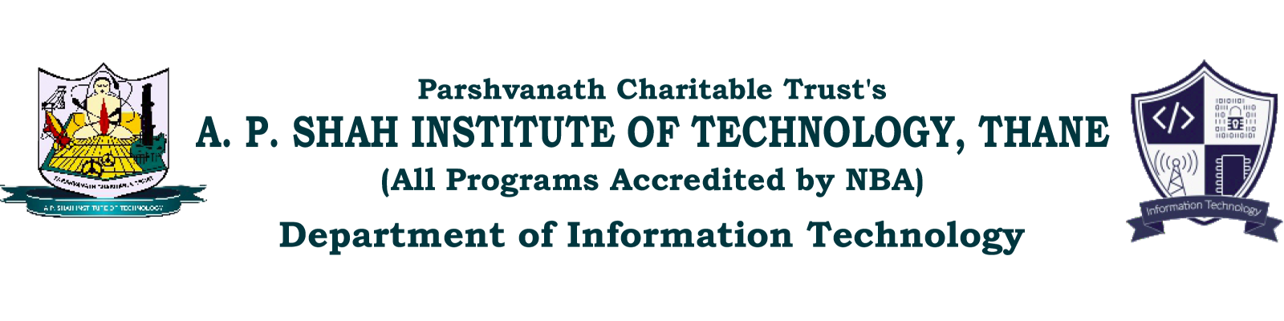
Plagiarism Checker
Dhruv Trivedi 21104129
Afif Shah 21104060
Manas Tare 21104025
Project Guide
Prof. Sonal Balpande

Slide 2
Contents
Introduction
Objectives
Scope
Features / Functionality
Project Outcomes
Technology Stack
Block Diagram if applicable

Slide 3
1. Introduction
A Plagiarism checker is a tool that compares a document to others available on the internet or in a database to determine if it contains plagiarized content. It is often used by educators, students, and professionals to ensure that their work is original and properly cited.
Problem Identified and Solution Proposed :
Academic Dishonesty: By detecting instances of plagiarism, plagiarism checkers help reduce incidents of academic dishonesty, such as cheating on assignments or passing off someone else's work as one's own.
Lack of Originality: Plagiarism checkers help ensure that written work is original and properly cited, reducing the likelihood of unintentional plagiarism.

Slide 4
1. Introduction
Poor Citation Practices: Plagiarism checkers help ensure that written work is properly cited, reducing the risk of incorrect or incomplete citations.
Reduced Quality of Written Work: By promoting ethical writing practices and encouraging proper research and citation, plagiarism checkers can help improve the overall quality of written work.
Legal Consequences: By detecting instances of plagiarism, plagiarism checkers can help prevent legal consequences such as copyright infringement.

Slide 5
2. Objectives
To detect instances of plagiarism in written work.
To promote ethical writing practices and reduce incidents of academic dishonesty.
To assist in ensuring the originality and authenticity of written work.
To improve the overall quality of written work by encouraging proper research and citation practices.
To provide peace of mind to students, educators, and professionals that their work is original and properly cited.
To assist in the detection and prevention of copyright infringement.

Slide 6
3. Scope
Educational institutions: Plagiarism checkers ensure original student work. Scope: teachers, professors, and students.
Professional settings: Plagiarism checkers prevent plagiarism in work documents. Scope: employers, employees, and clients.
Content creators: Plagiarism checkers ensure originality in writing. Scope: writers, editors, and publishers.
Legal settings: Plagiarism checkers ensure original legal documents. Scope: lawyers, judges, and other legal professionals.

Slide 7
4. Feature /Functionality
Text Comparison
The ability to compare written work to a large database of online and offline sources to detect instances of plagiarism.
Text Matching
The ability to identify instances of identical or nearly identical text in a document, indicating potential plagiarism.
Paraphrasing Detection
The ability to detect instances of plagiarism that involve paraphrasing or rewording of text from another source.

Slide 8
4. Feature /Functionality
Grammar and Spell Checking
The ability to detect instances of plagiarism that result from poor grammar or spelling, such as incorrect citations or misspelled words.
Visual Media Support
The ability to detect instances of plagiarism in visual media such as images.
Report Generation
The ability to generate a comprehensive report indicating instances of plagiarism and the sources from which the text was copied

Slide 9
5. Outcome of Project
Improved Originality of Written Work
Enhanced Reputation
Increased Efficiency
Improved Compliance
Enhanced Learning
Increased Confidence

Slide 10
6. Technology Stack
For front end (GUI) – HTML, CSS.
For backend – Python, Flask, MongoDB.

Slide 11
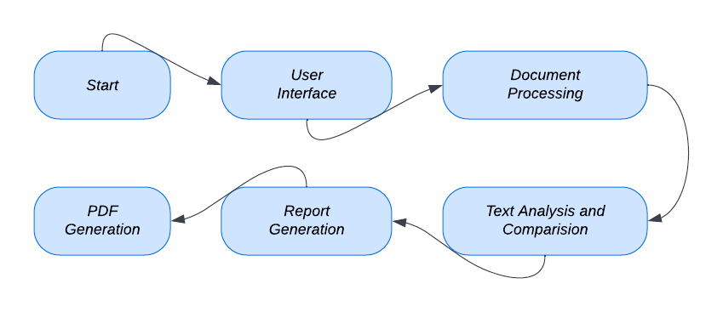
7. Block Diagram ( if applicable)

Slide 12
Thank You...!!

